Slide 1
ADF Season 2025 –
Project Cards
Highly Confidential
28 January 2025 Rev 00

Slide 2
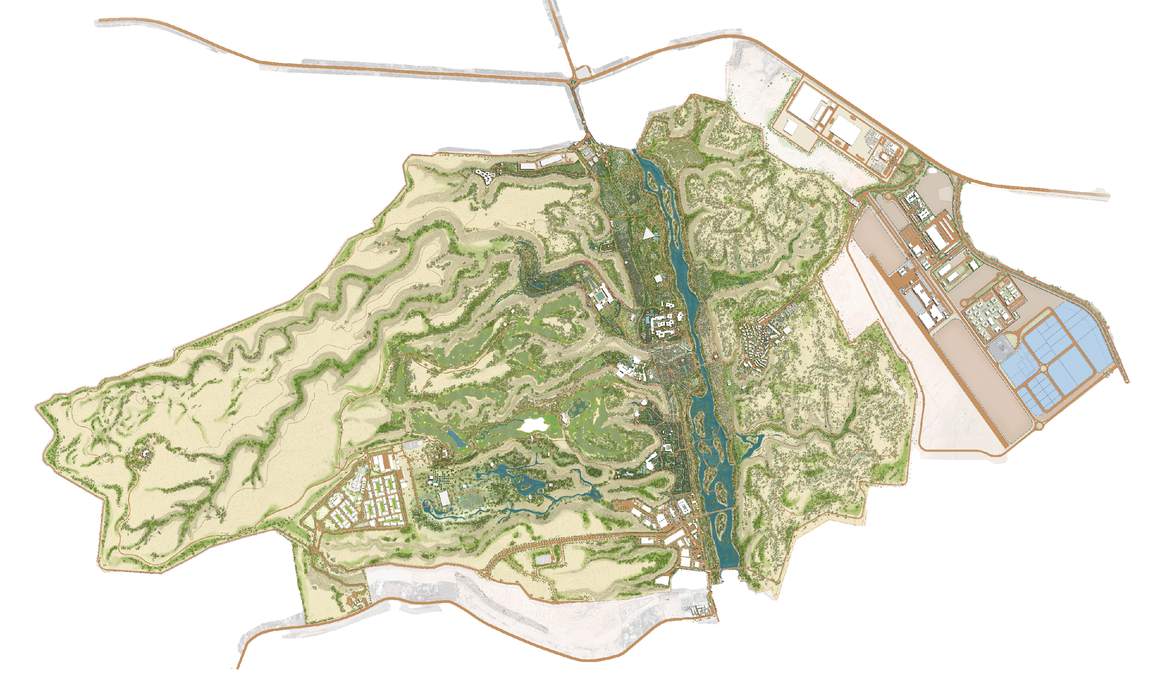
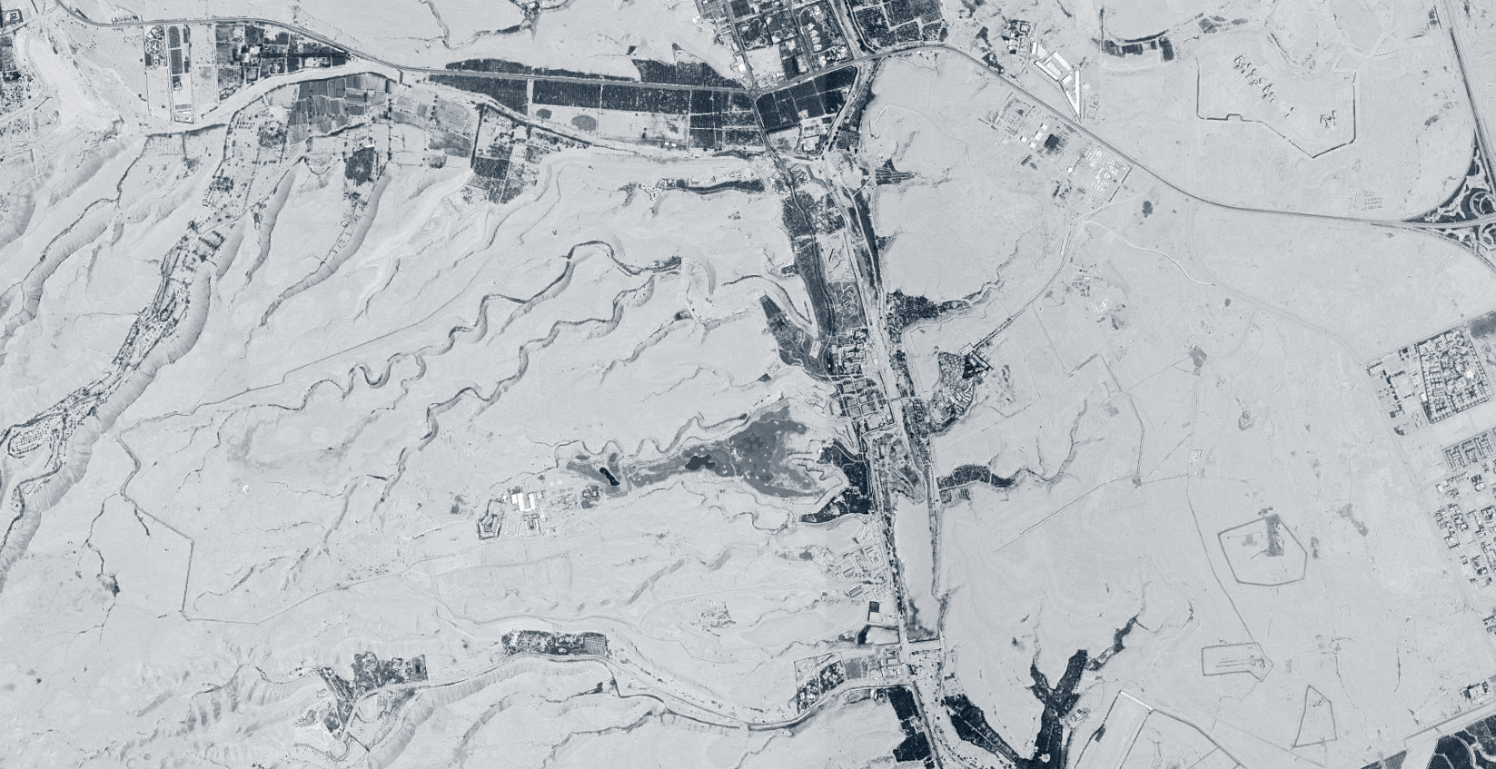
ADF Projects Masterplan
15
14
15
17
9
14
17
12
17
3
8
13
2
20
6
6
7
10
14
15
17
6
6
6
4
6
1
6
6
6
17
6
5
5
5
17
11
14
19
17
11
18
15
16
15
15
17
16
9
14
16
No. | Royal Projects
No. | Landscape Projects
No. | Infra & Utilities Projects
No. | Security and Operations Projects
No. | Security and Operations Projects
1 | Prince's Palace
2 | POD 1 + Variation
3 | POD 2 + Variation
4 | Gaming Centre
5 | Golf Course Phase 1 + 2a
6 | Golf Course Phase 2B
7 | L. IP Front Garden (Zone 1, 2,3, 4)
8 | L. POD 2
9 | Wadi Bridges (2nr)
10 | Service Tunnel
11 | Infrastructure - South
12 | Infrastructure - North
13 | Eastlands Infrastructure
14 | East Boundary Wall
15 | Eastlands Boundary Wall (Zone F)
16 | South Boundary Wall
17 | West & North Boundary Wall
18 | New South Royal Gate
19 | Operation Facilities
20 | Private Garage (Excl Future Expansion)

Slide 3
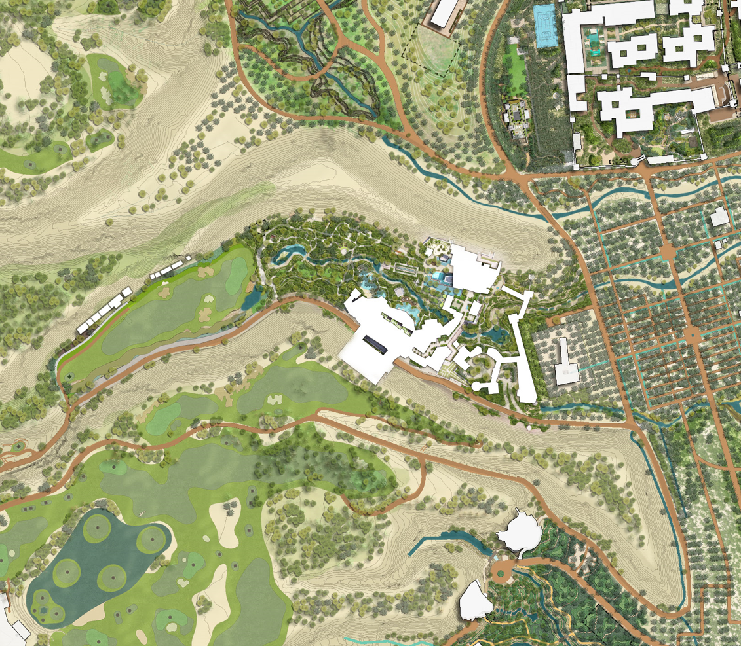
1
Project Name | Project Status | Design Status | Construction Start Date | Target Completion Date | Forecast Completion Date | Overall Progress | Current Project Cost | Forecast to Complete | Cost / m2
Project Key Stats
Site Area
Built Up Area
Project Configuration
Space Programme | FOH
 | BOH
Project Cost & Cost Analysis
Current Construction & Payment Progress
Current Project Cost
00
Design & Supervision
Civil, Structural & Finishes
FF&E /Specialties
Services
External Works
Prelims, OH&P
Client Direct
Contingencies
Variations
VAT
Forecast Construction Spend 2025
Construction
Progress
Payment
Progress
7%
5%
Basis Of Project Cost
Estimated Total Required Avg. Daily Resources
Daily Manpower | Daily Machinery
Remaining Items
Risk Assessment

Slide 4
Index
 |  | Projects
Royal | 1 | Prince's Palace
Royal | 2 | POD 1 + Variation
Royal | 3 | POD 2 + Variation
Royal | 4 | Gaming Centre
Landscape | 5 | Golf Course Phase 1 + 2a
Infra & Utilities | 6 | Golf Course Phase 2B
Infra & Utilities | 7 | L. IP Front Garden (Zone 1 to 4)
Infra & Utilities | 8 | L. POD 2
Infra & Utilities | 9 | Wadi Bridges (2nr)
Infra & Utilities | 10 | Service Tunnel
Infra & Utilities | 11 | Infrastructure - South
Infra & Utilities | 12 | Infrastructure - North
Infra & Utilities | 13 | Eastlands Infrastructure
Security & Ops | 14 | Operation Facilities
Security & Ops | 15 | Private Garage (Excl Future Expansion)
Security & Ops | 16 | East Boundary Wall
Security & Ops | 17 | Eastlands Boundary Wall (Zone F)
Security & Ops | 18 | South Boundary Wall
Security & Ops | 19 | West & North Boundary Wall
Security & Ops | 20 | New South Royal Gate

